Slide 1
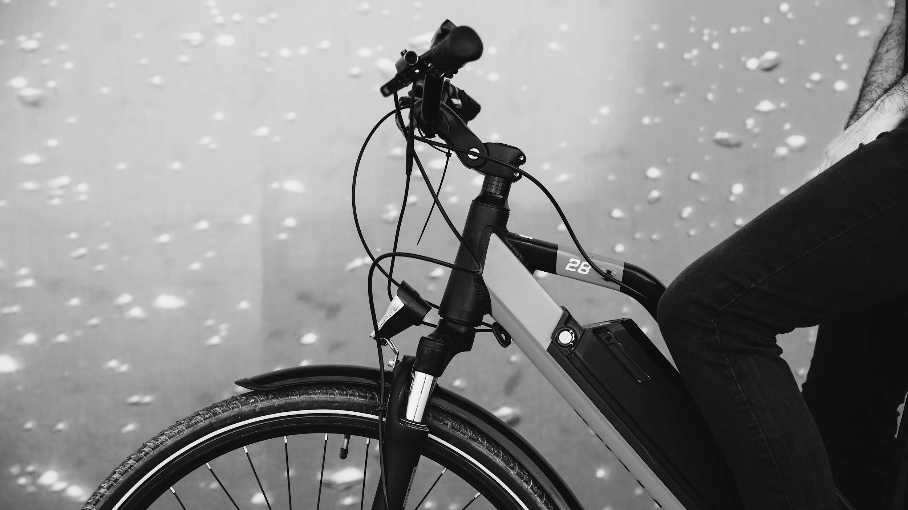
Lighthouse Labs DS
Project: Statistical Modeling with Python
By Jamie Dormaar. Dec 5th, 2022
Project:
02

Slide 2
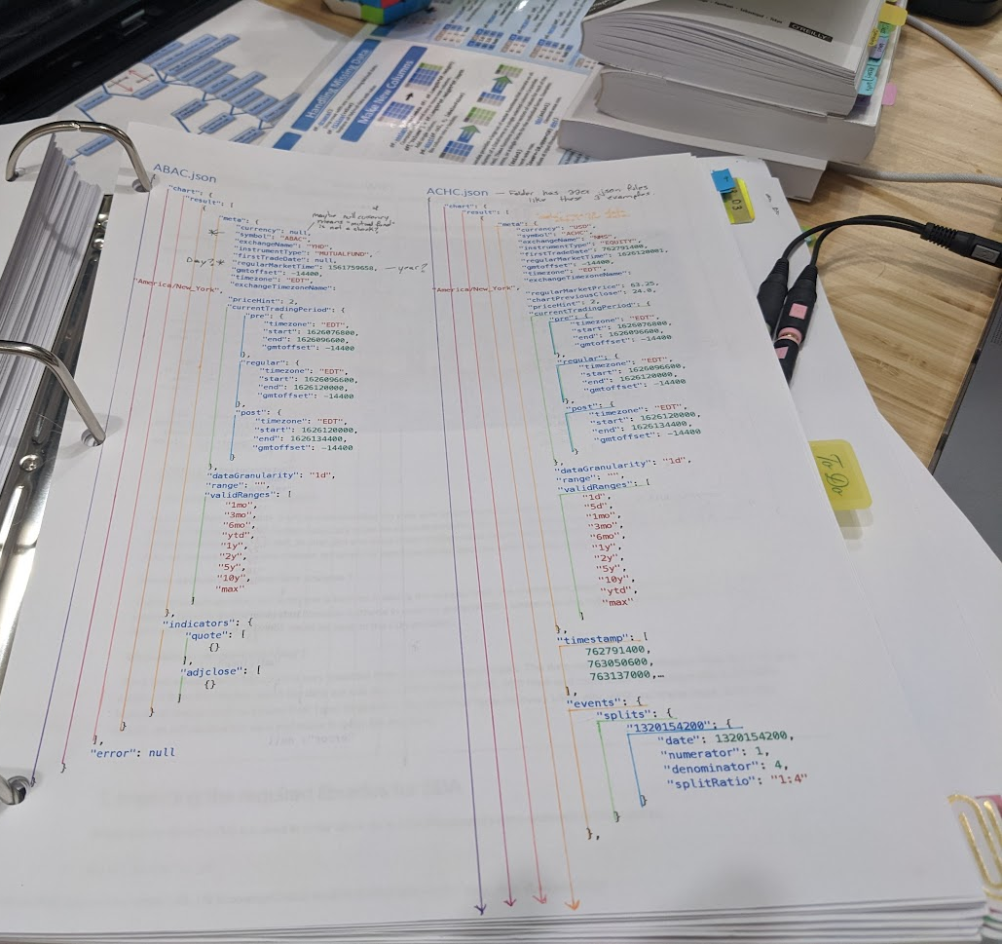
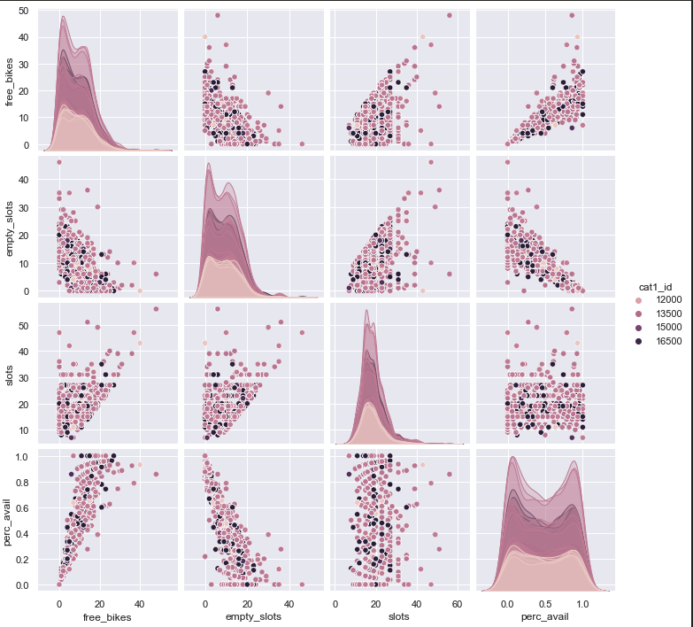
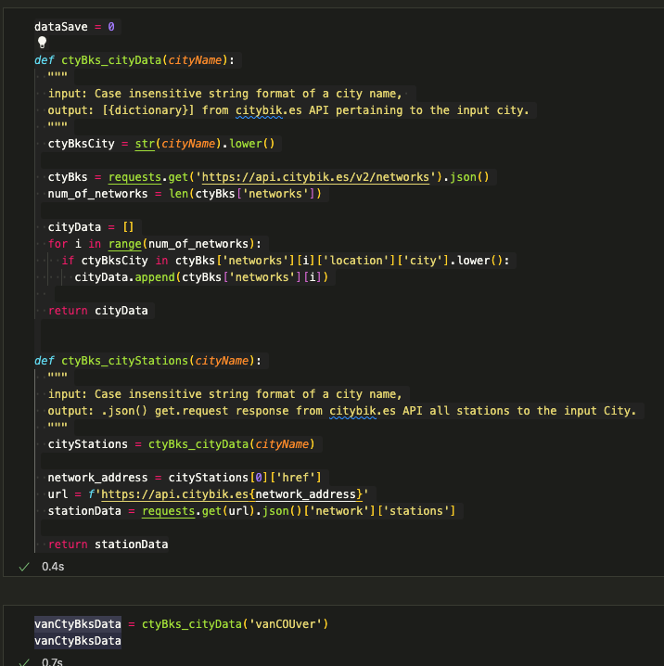
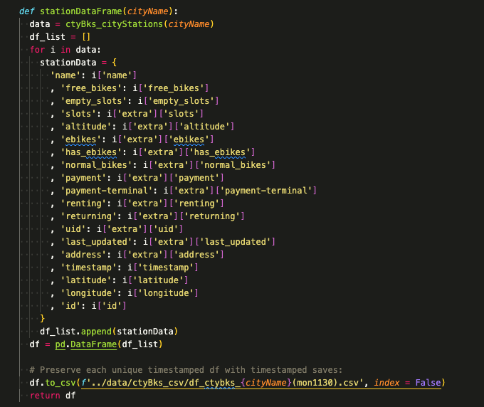
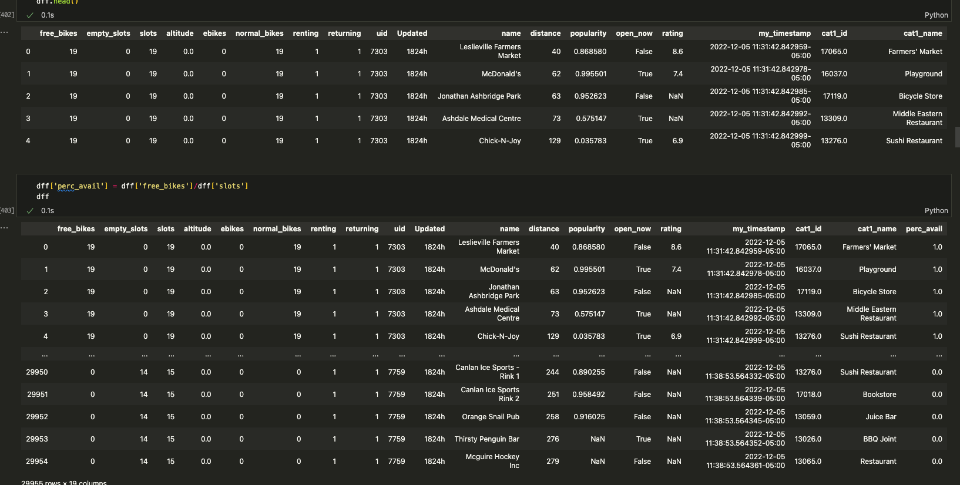
EDA is an iterative Process :
SO MUCH Learning!!
Statistical analysis
JSON data
Despite red, Mars is beingactually a cold place
APIs
Exploring and transforming data
Putting it all together in
Python

Slide 3
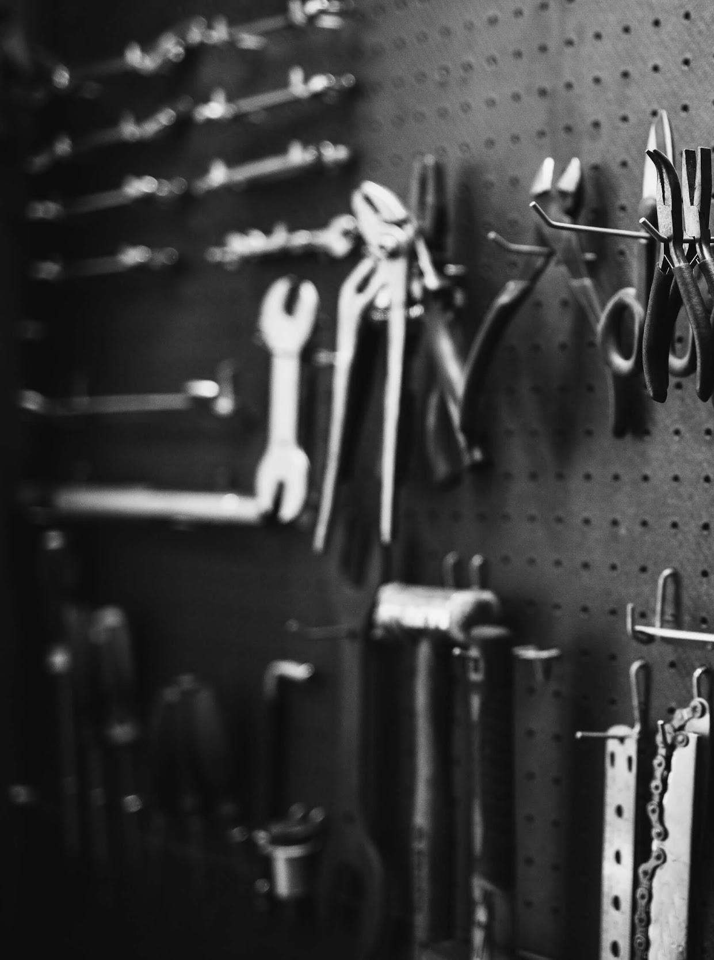
My Context
Bike Share User Group
01
What/Why
02
When
03
Who is using the bike share? (without access to user data)
Using other API data on vendors/businesses.
Does bike availability change at certain bike stations, at various dimes of day/ day of week?

Slide 4
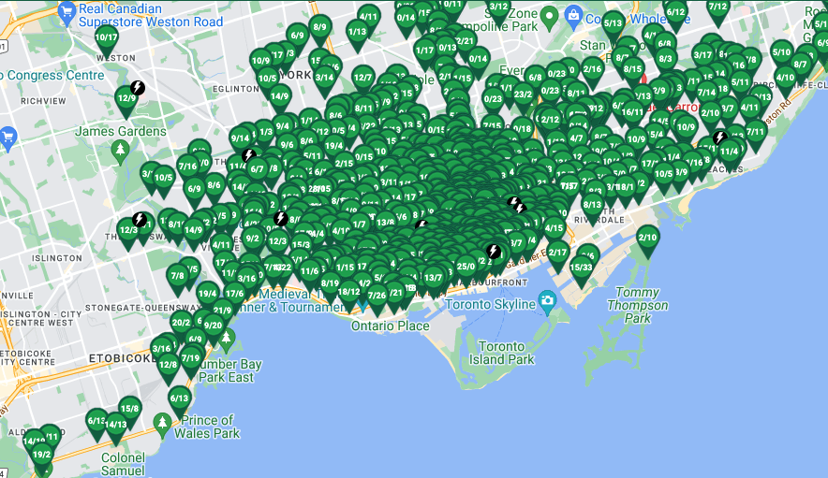
The Plan
Bike Share User Group
01
03
When
What/Why
Toronto Bike Share
Who is using the bike share? (without access to user data)
Collect all the data from Citybik.es API, Foursquare API and Yelp API, Keep only what I need to analyze correlations!
Does bike availability change at certain bike stations, at various dimes of day/ day of week?
Using other API data on vendors/businesses.

Slide 5
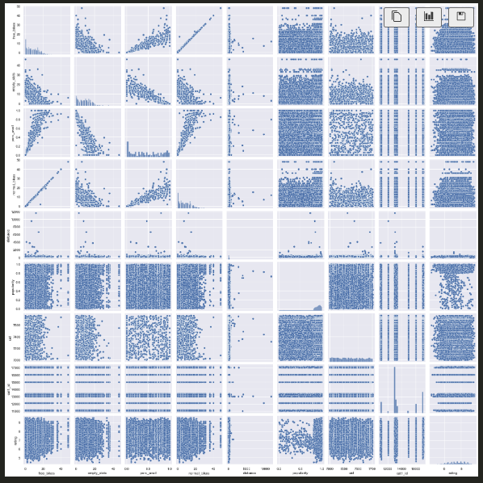
xx
The Plan
Bike Share User Group
01
What/Why
Toronto Bike Share
The Plan
Bike Share User Group
01
Who is using the bike share? (without access to user data)
Collect all the data from Citybik.es API, Foursquare API and Yelp API, Keep only what I need to analyze correlations!
NO correlations
…
Collect all the data from Citybik.es API, Foursquare API and Yelp API, Keep only what I need to analyze correlations!

Slide 6
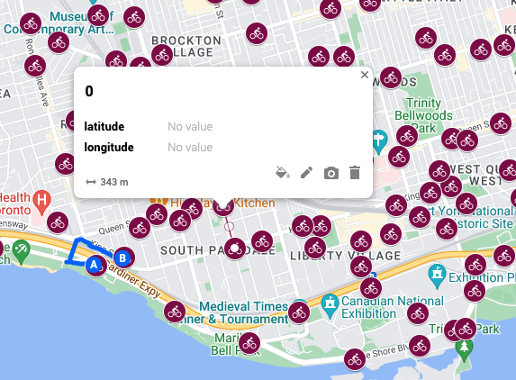
The Plan
Bike Share User Group
02
03
When
What/Why
Toronto Bike Share
Who is using the bike share? (without access to user data)
~ average distance between bike stations is only 350m.
The 1000m radius we were told to use, overlaps too many stations in this city!
Does bike availability change at certain bike stations, at various dimes of day/ day of week?
Using other API data on vendors/businesses.

Slide 7
The Plan
Bike Share User Group
02
When
What/Why
03
Toronto Bike Share
Who is using the bike share? (without access to user data)
~ average distance between bike stations is only 350m.
The 1000m radius we were told to use, overlaps too many stations in this city!
xx
NO correlations
…
Using other API data on vendors/businesses.
Does bike availability change at certain bike stations, at various dimes of day/ day of week?

Slide 8
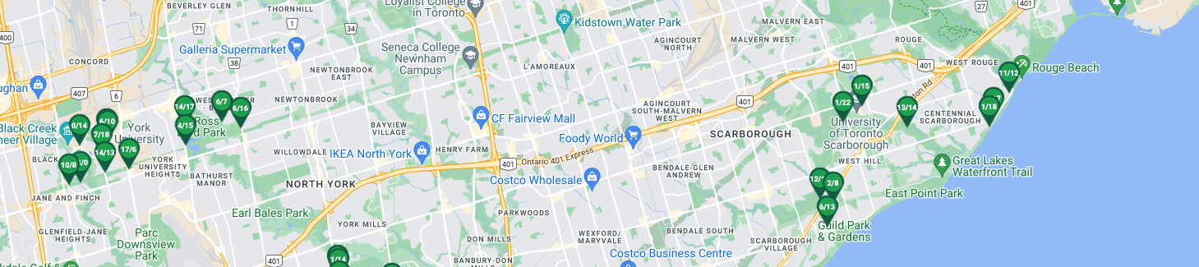
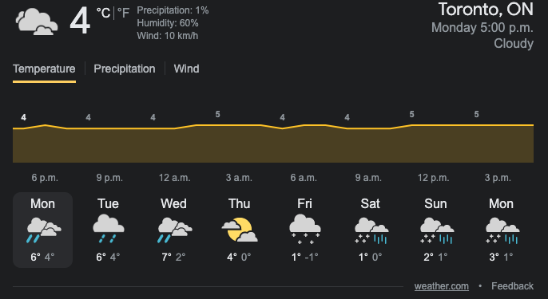
The Plan
Bike Share User Group
03
03
When
What/Why
Toronto Bike Share
Who is using the bike share? (without access to user data)
It is winter. Not unbearable in Toronto, but not really fun.
Students are extreme creatures!
Does bike availability change at certain bike stations, at various dimes of day/ day of week?
Using other API data on vendors/businesses.

Slide 9
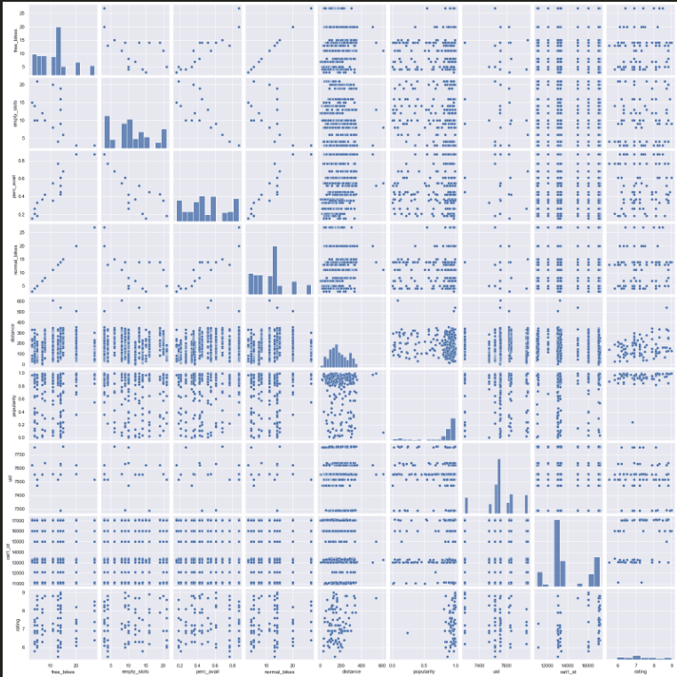
The Plan
Bike Share User Group
03
03
When
What/Why
Toronto Bike Share
Who is using the bike share? (without access to user data)
It is winter. Not unbearable in Toronto, but not really fun.
Students are extreme creatures!
xx
NO correlations
…
Does bike availability change at certain bike stations, at various dimes of day/ day of week?
Using other API data on vendors/businesses.

Slide 10
The Plan
Bike Share User Group
03
03
When
What/Why
Toronto Bike Share
Who is using the bike share? (without access to user data)
It is winter. Not unbearable in Toronto, but not really fun.
Students are extreme creatures!
I’ll pull out cafes and coffee shops near the Universities, and cross analyze that!
Does bike availability change at certain bike stations, at various dimes of day/ day of week?
Using other API data on vendors/businesses.

Slide 11
The Plan
Bike Share User Group
03
03
When
What/Why
Toronto Bike Share
Who is using the bike share? (without access to user data)
It is winter. Not unbearable in Toronto, but not really fun.
Students are extreme creatures!
I’ll pull out cafes and coffee shops near the Universities, and cross analyze that!
xx
NO correlations
…
Does bike availability change at certain bike stations, at various dimes of day/ day of week?
Using other API data on vendors/businesses.

Slide 12
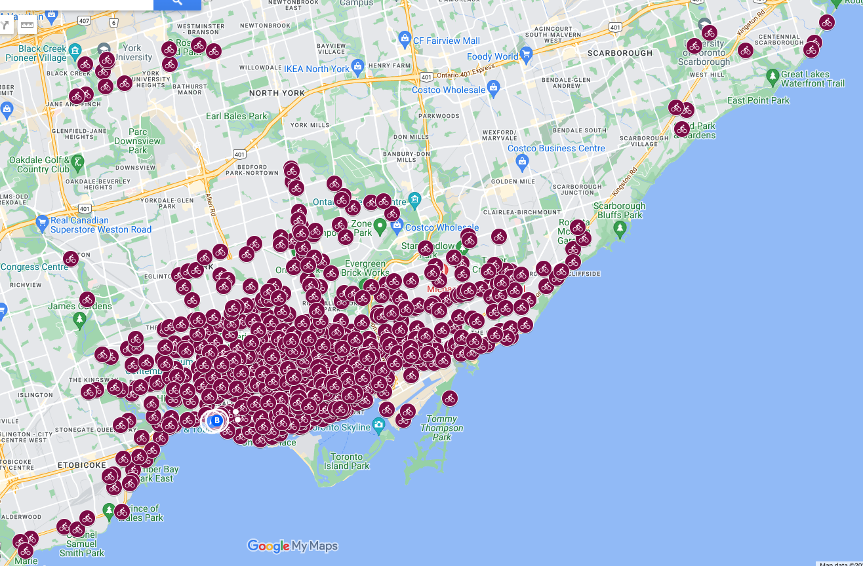
The Plan
Bike Share User Group
03
03
When
What/Why
Toronto Bike Share
Who is using the bike share? (without access to user data)
Google maps
Uploaded csv of all the Toronto bike stations:
citybikes
Does bike availability change at certain bike stations, at various dimes of day/ day of week?
Using other API data on vendors/businesses.

Slide 13
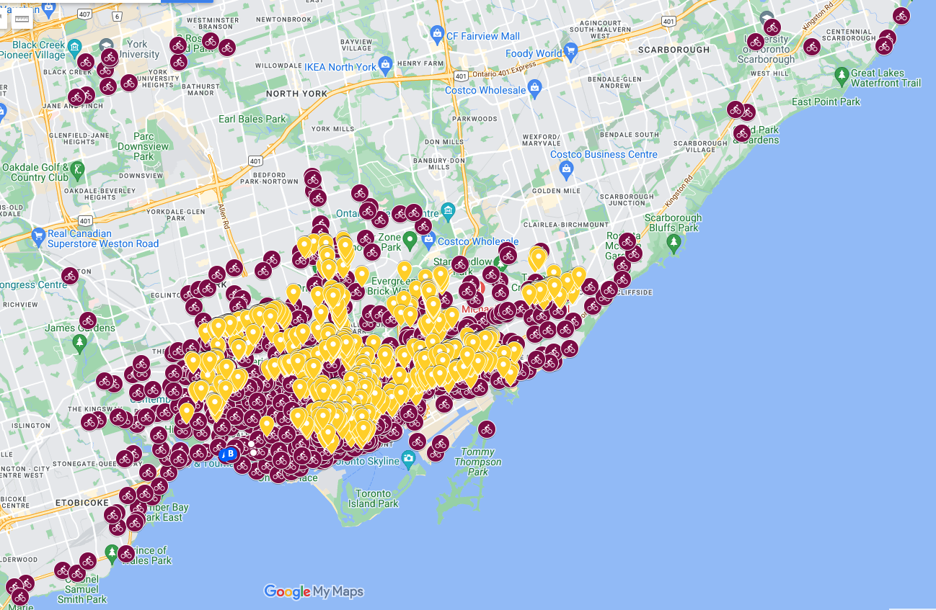
The Plan
Bike Share User Group
03
Yelp
When
What/Why
Toronto Bike Share
Who is using the bike share? (without access to user data)
Google maps
Uploaded csv of all the Toronto bike stations:
Layered over the Yelp POI location coordinates:
Does bike availability change at certain bike stations, at various dimes of day/ day of week?
Using other API data on vendors/businesses.

Slide 14
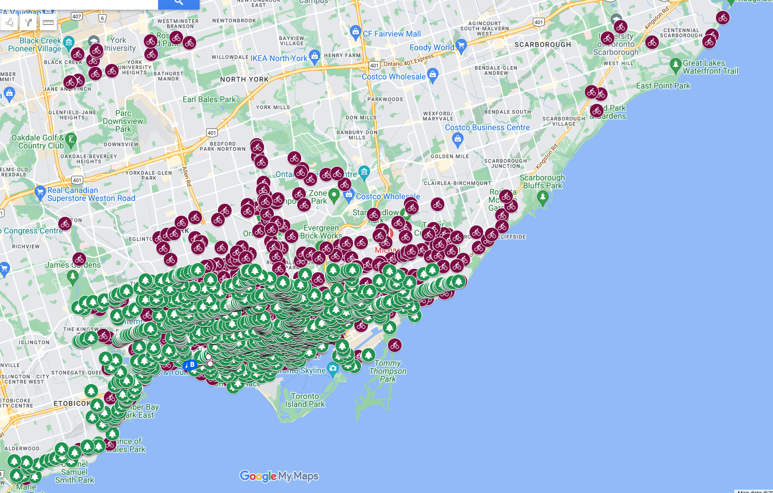
The Plan
Bike Share User Group
03
Foursquare Parks
When
What/Why
Toronto Bike Share
Who is using the bike share? (without access to user data)
Google maps
Uploaded csv of all the Toronto bike stations:
Layered over the foursquare POI location coordinates that specified “parks” as a category type:
Does bike availability change at certain bike stations, at various dimes of day/ day of week?
Using other API data on vendors/businesses.

Slide 15
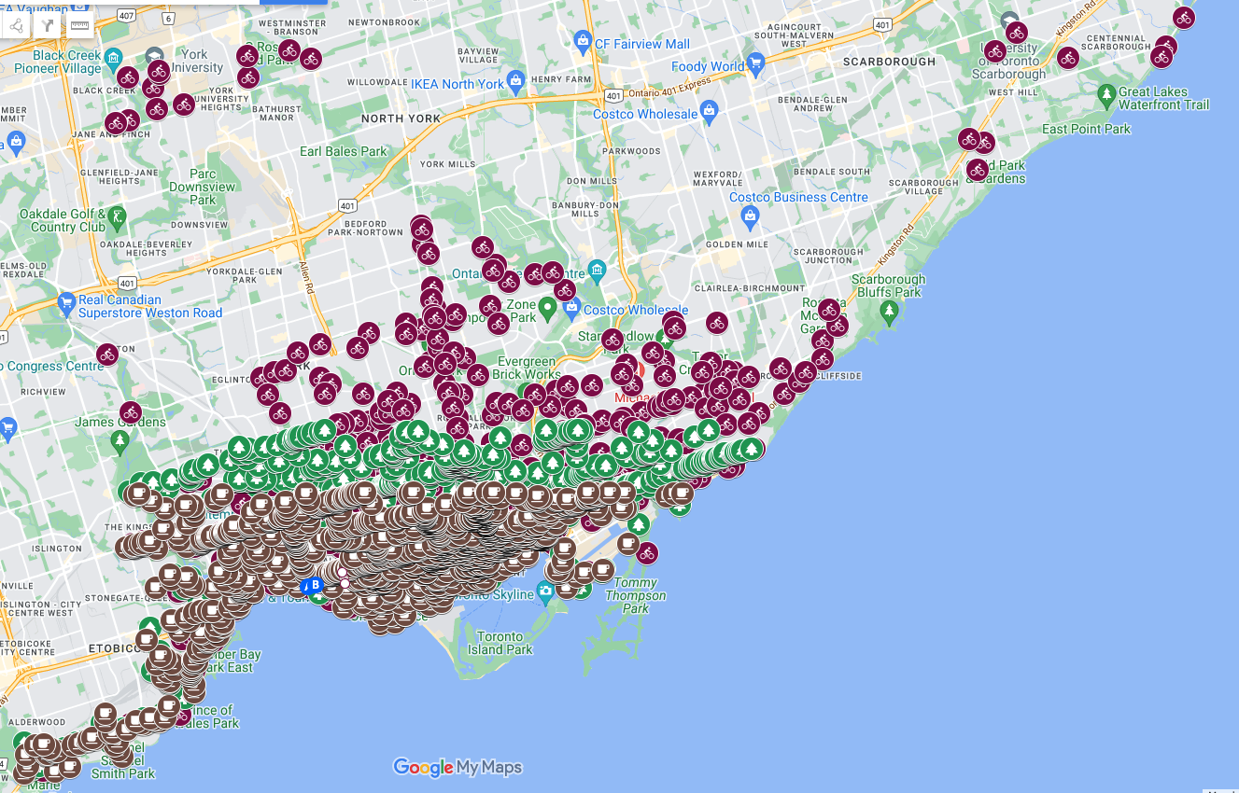
The Plan
Bike Share User Group
03
Foursquare Parks + Coffee!!
When
What/Why
Toronto Bike Share
Who is using the bike share? (without access to user data)
Google maps
Uploaded csv of all the Toronto bike stations:
Layered over the foursquare POI location coordinates that specified “parks” as a category type:
Does bike availability change at certain bike stations, at various dimes of day/ day of week?
Using other API data on vendors/businesses.

Slide 16
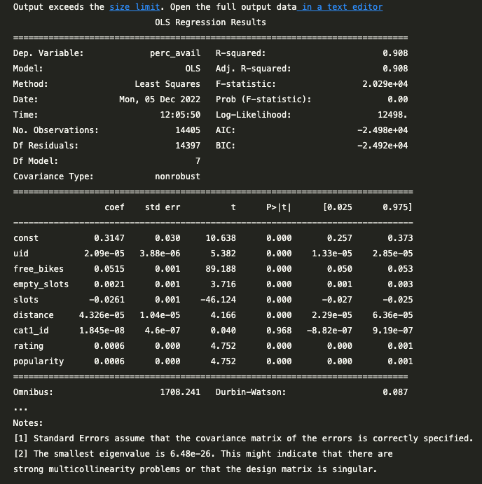
Best Sellers
Road Model
Urban odel
Despite being red, Mars is a cold place
10M sold
Saturn is the ringed one and a gas giant

Slide 17
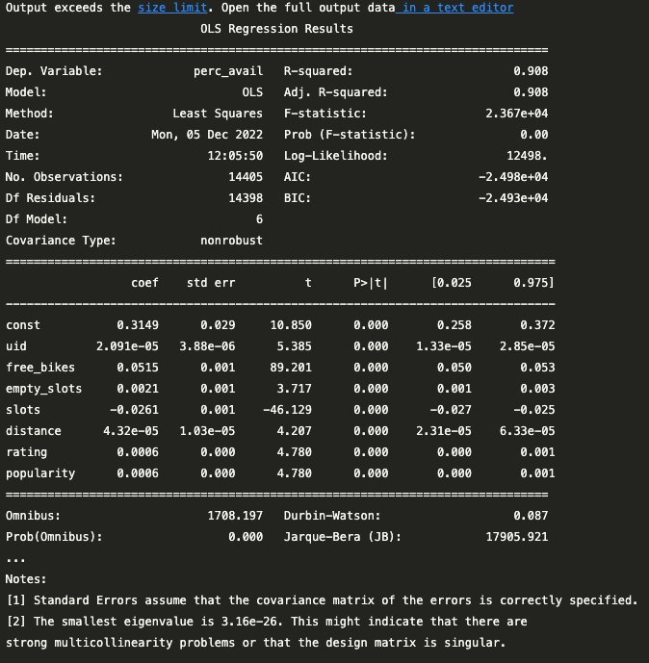
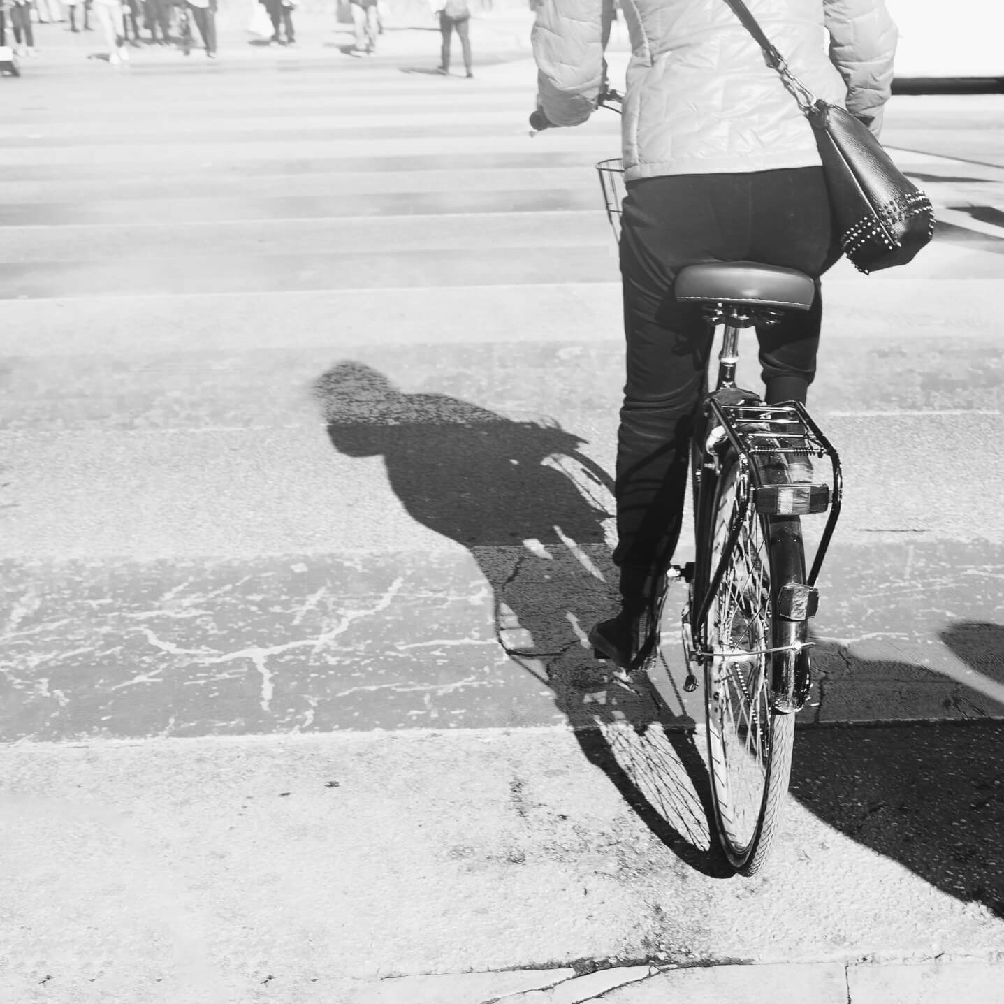
Best Sellers
Road Model
Urban Model
Despite being red, Mars is a cold place
Saturn is the ringed one and a gas giant
10M sold
3M sold

Slide 18
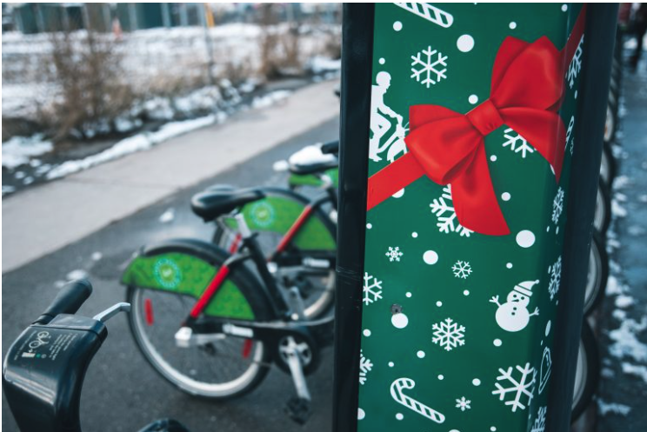
Thanks
Any questions?
jdormaar@gmail.com
Lighthouse Labs Data Science
Please keep this slide for attribution

